Slide 1
Expertise, Trust and Democracy
Sheila Jasanoff
Harvard University, Cambridge , MA 02138
August 12, 2019

Slide 2
Existential Questions
Who are we?
http://sts.hks.harvard.edu/
Why are we here?
http://sts.hks.harvard.edu/events/sts-summer-school-expertise-trust-and-democracy/
Where are we coming from?
What will we do?

Slide 3
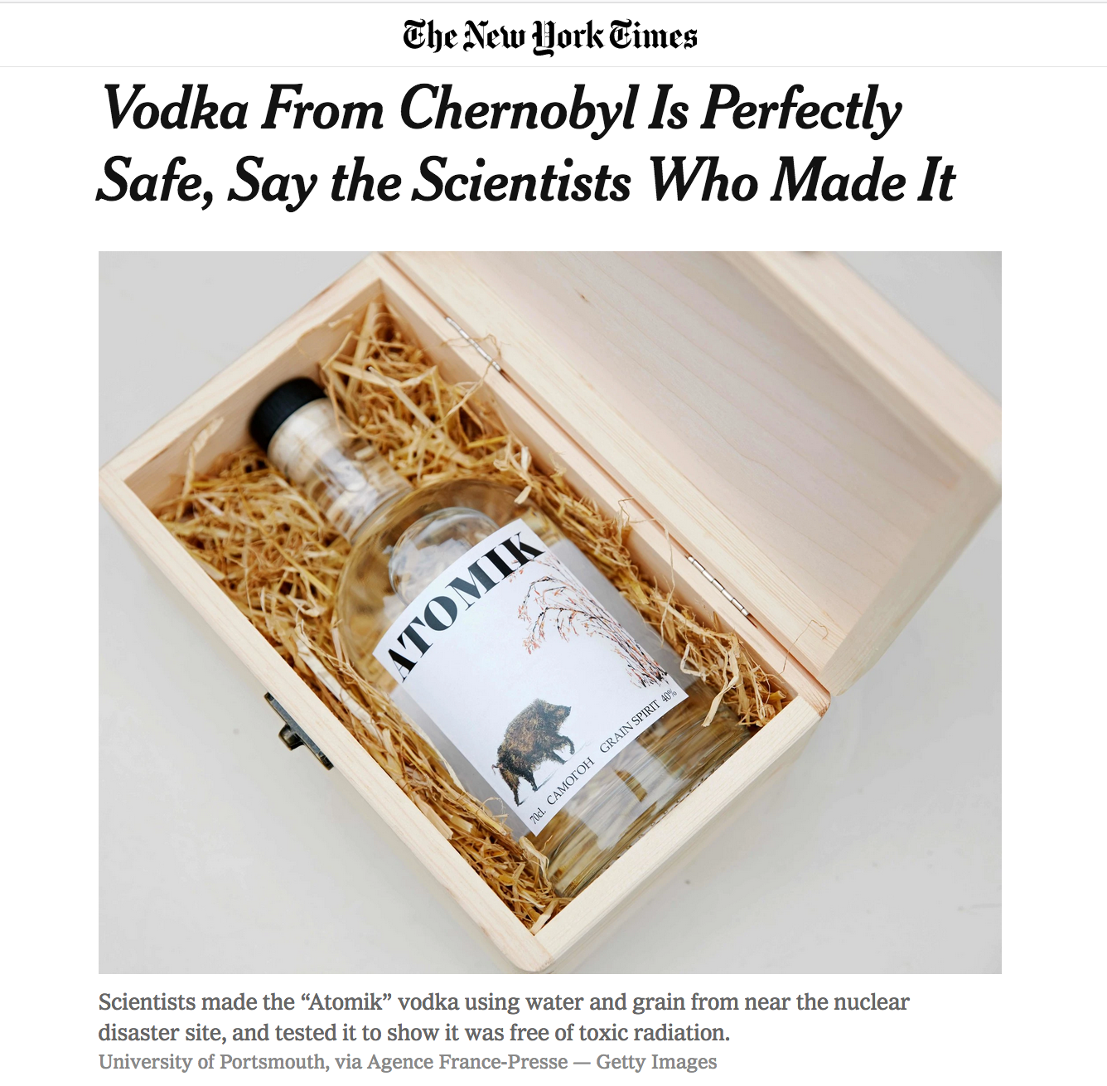
“It’s not groundbreaking science,” Professor Smith
said of the results, adding that the group had
expected the result. “But if we want to sell it in the
future, we need to have the science there.”

Slide 4
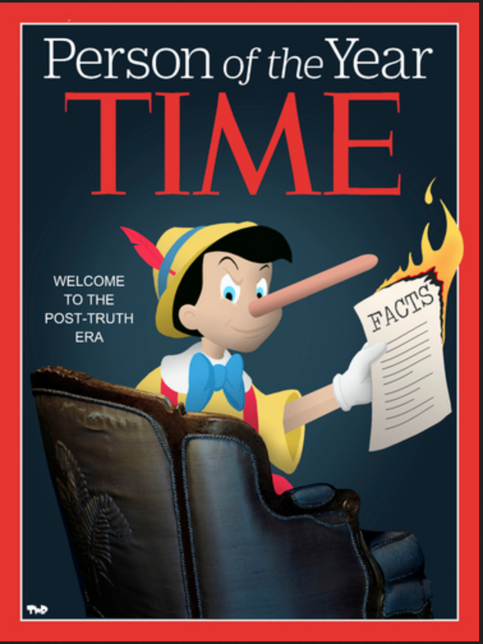
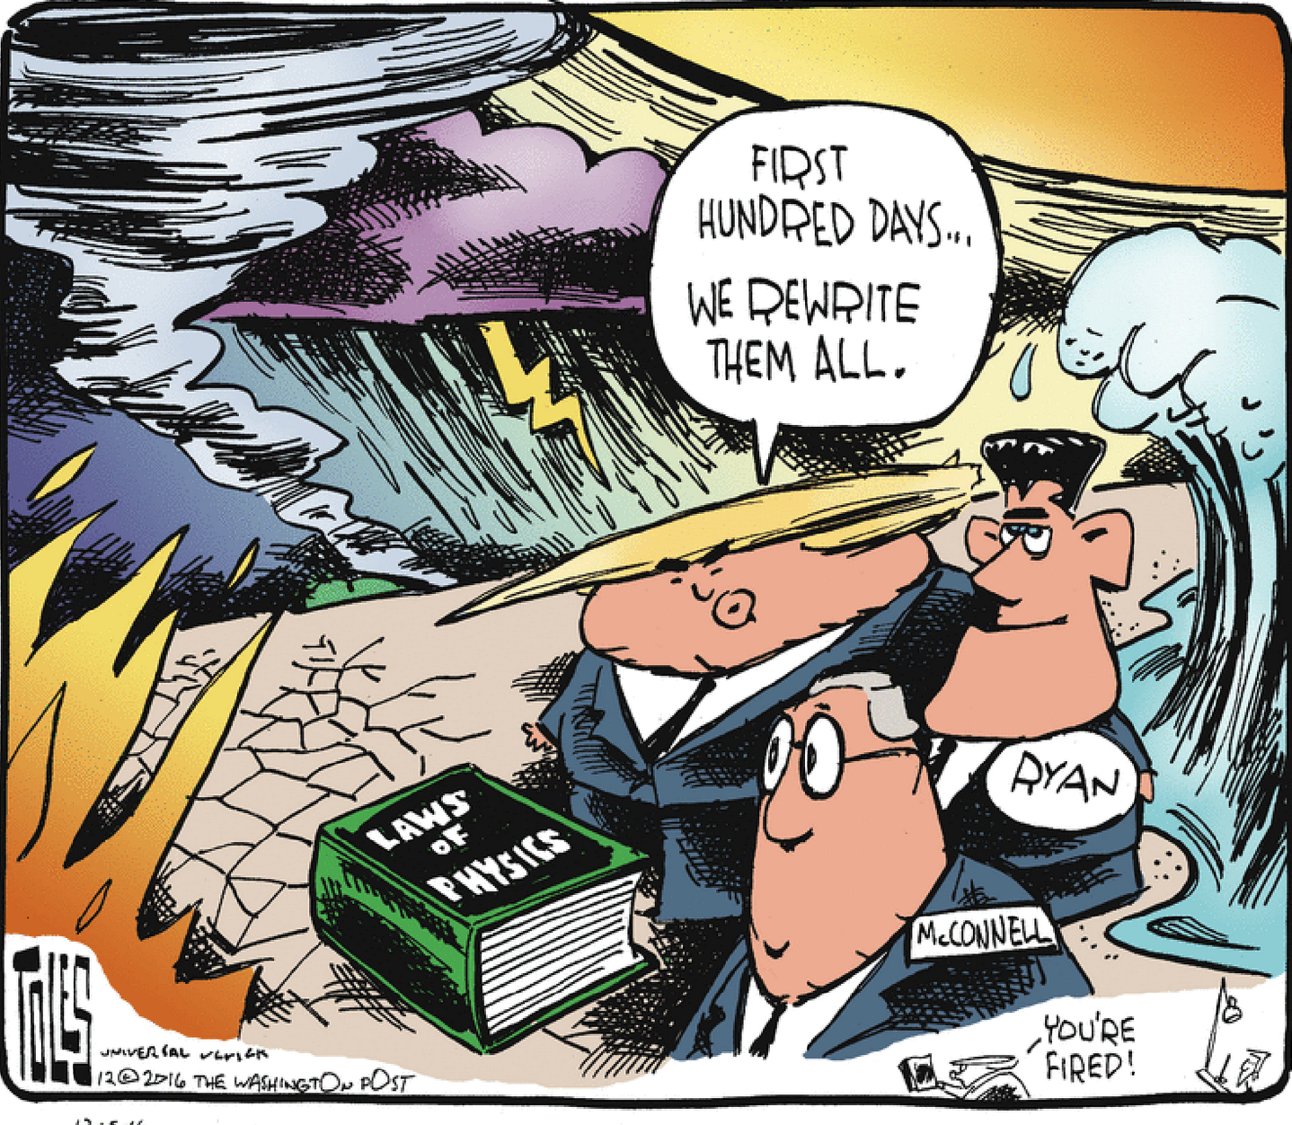
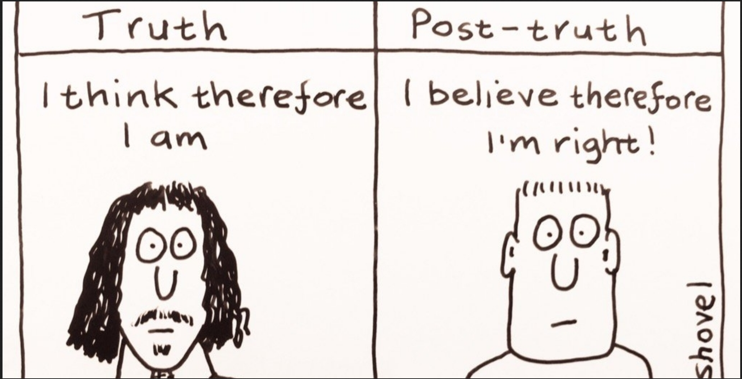
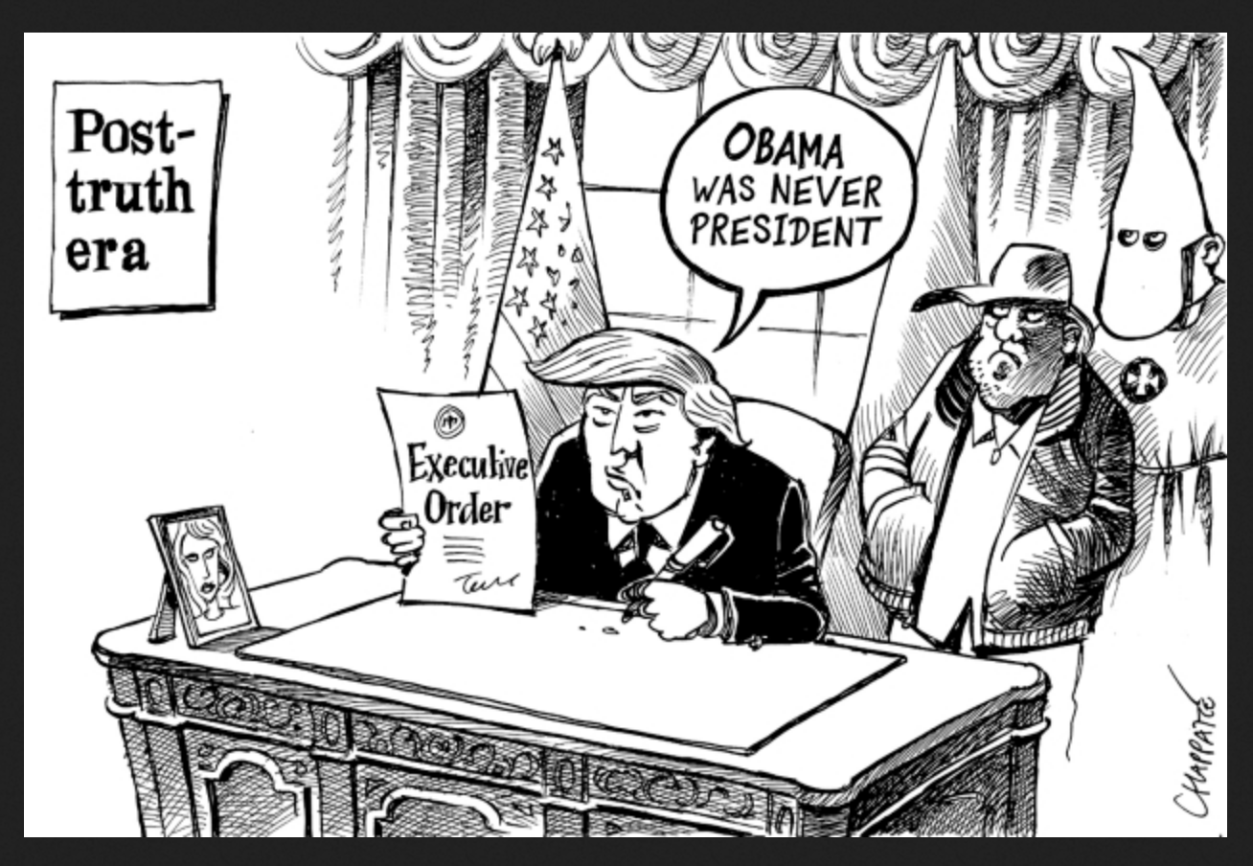

Slide 5
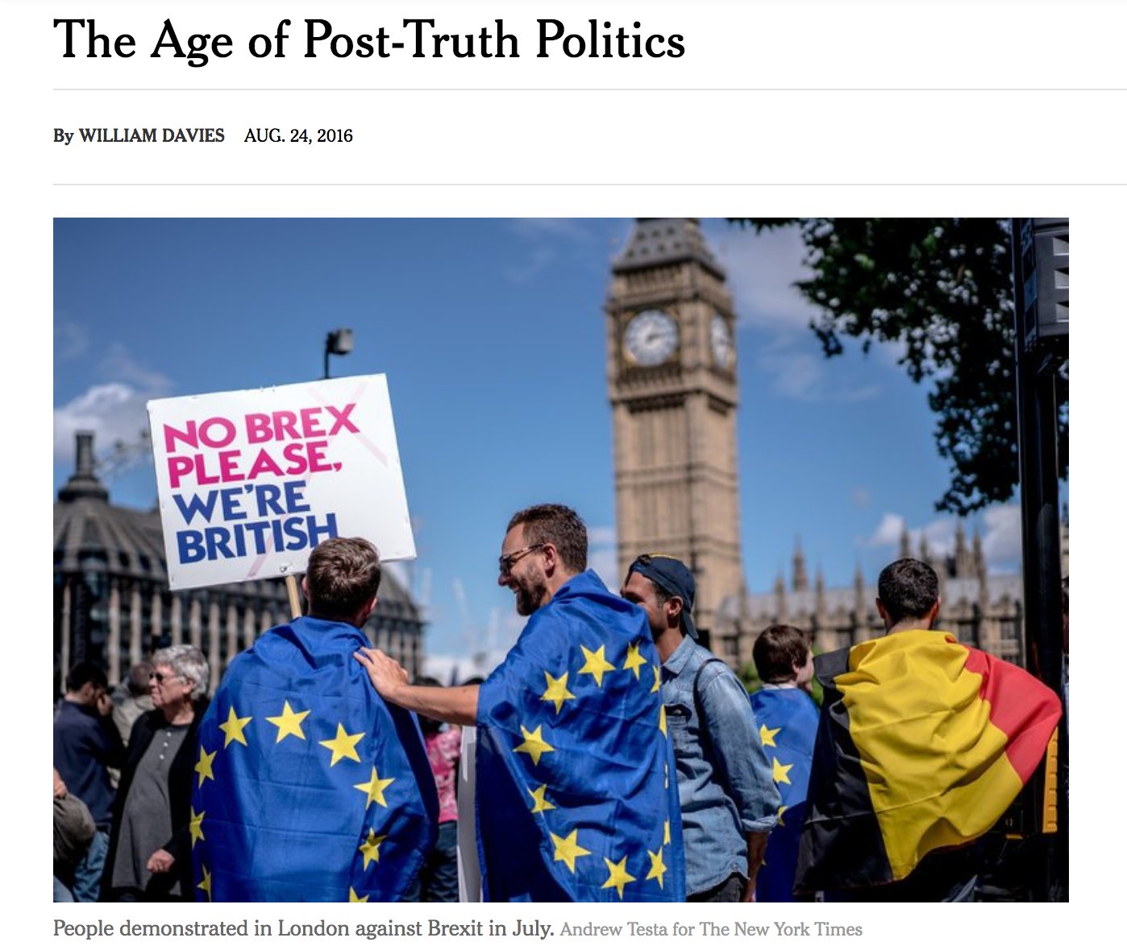
Newspapers might provide resistance to the
excesses of populist demagogy, but not to the
broader crisis of facts.
The problem is the oversupply of facts in the
21st century: There are too many sources,
too many methods, with varying levels of
credibility, depending on who funded a given study
and how the eye-catching number was selected.

Slide 6
Crisis of Expertise

Slide 7
Fact Focused: Production
Uptake Focused: Reception
What was the evidence?
How was it evaluated?
Was it by qualified experts?
How were disagreements resolved?
Are the conclusions credible?
Who asked the questions?
Whose claims were heard?
Was relevant expertise excluded?
Was dissent allowed, and if not why not?
Are the conclusions legitimate?

Slide 8
Why does the starting point matter?
Where is the problem?
If facts are (produced) right, then the problem (deficit) is in the recipient, the audience, the medium of communication.
Alternatively, the facts are not being produced right because of corruption, capture, manufactured uncertainty.
If the breakdown is in trust (uptake, reception), not the facts, then the problem is in the relations between science and society – and the state.

Slide 9
Three Organizing Threads
Longue durée: protracted controversies; cross-cultural divergences (nuclear power, GMOs, climate change)
Institutions: law, government, media, education, corporations
Democracy: publics, participatory mechanisms, communication

Slide 10
Theory and Scholarship

Slide 11
Instructors
STS scholars
International community
Members of Science and Democracy Network
Many collaborative intersections

Slide 12
Interludes
Practitioner interactions (M-Th)
Professors Bunn, J. McCarthy, G. McCarthy
Media professionals
MIT Media Lab (W)
Can technology solve the crisis of expertise?
Your contributions (F)
Free time (W)

Slide 13
What you’re asked to do
Work in teams of two
Write 750-1000 words
An opinion piece or policy recommendation focused on either of the following:
One of the issues discussed during the week OR a salient, current controversy of your choice
The perceived crisis of expert credibility as it is presented in one or two pieces drawn from the STS Program’s “Post-truth Reader”
A critical response to the discussion of science or expertise that took place in one of the summer school sessions up till Wednesday (including your Media Lab visit).
Present in class Friday.

